Slide 1
Using the sine ratio
Trigonometry

Slide 2
How our teaching resources are designed for the classroom

Slide 3
I can use the sine ratio to find the missing side or angle in a right-angled triangle.

Slide 4
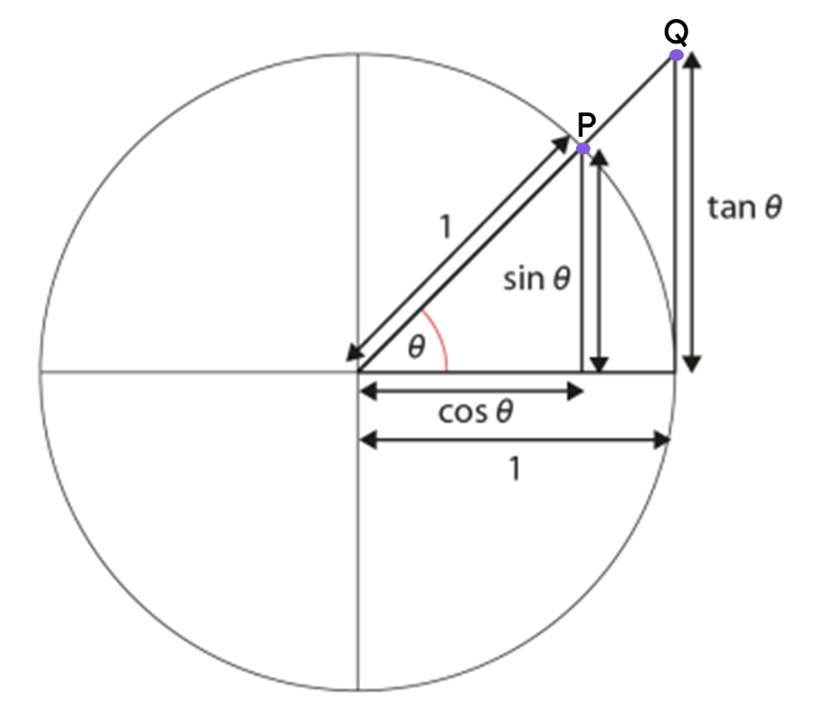
The hypotenuse is the side of a right-angled triangle which is opposite the right angle.
The opposite side of a right-angled triangle is the side which is opposite the marked angle.
Trigonometric functions are commonly defined as ratios of two sides of a right-angled triangle for a given angle.
The sine of an angle (sin(θ°)) is the y-coordinate of point P on the triangle formed inside the unit circle.

Slide 5

Using the sine ratio
Formalising the sine formula
Calculating angles using the sine formula

Slide 6
Formalising the sine formula
We know that these two triangles are similar, as two of the angles in one triangle are equal to two angles in the other.
We can find the length of the side labelled x by using a ratio table.
× 0.67
1
0.67
× 12
× 12
12
0.67 × 12
× 12
8.04
× 0.67
12 cm
8.04 cm
x cm
1 cm
0.67 cm
42°
42°

Slide 7
Formalising the sine formula
We can also generalise this process to any right-angled triangle that has an angle θ°, where the side opposite θ° has length sin(θ°).
× sin(θ°)
1
sin(θ°)
× h
× h
h
h × sin(θ°)
× h
opp
× sin(θ°)
h cm
h × sin(θ°)
opp
1 cm
sin(θ°)
θ°
θ°

Slide 8
Formalising the sine formula
We can also generalise this process to any right-angled triangle that has an angle θ°, where the side opposite θ° has length sin(θ°).
1
sin(θ°)
h cm
h
opp
opp
h × sin(θ°)
h × sin(θ°)
× sin(θ°)
θ°
The length of the hypotenuse
multiplied by the sine of an angle of θ°
equals the length of the side opposite that angle.

Slide 9
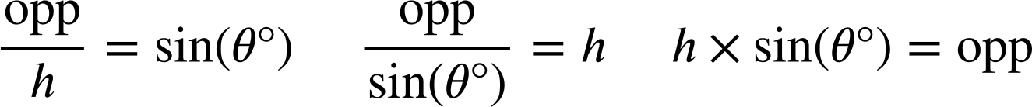
Formalising the sine formula
We can use this ratio table to generate a formula that shows the relationship between the side opposite angle θ° and the hypotenuse, and represent that formula in three ways.
× sin(θ°)
1
sin(θ°)
sin(θ°)
× h
× h
÷ h
h
opp
h
opp
× sin(θ°)
÷ sin(θ°)
× sin(θ°)
h × sin(θ°)
h cm
opposite
θ°

Slide 10
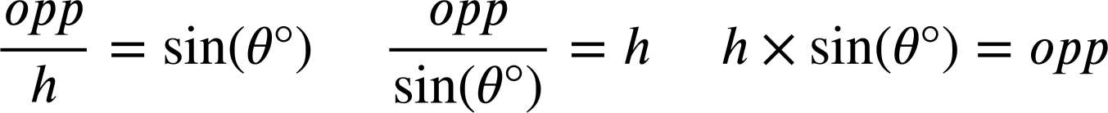
Formalising the sine formula
We can also derive two versions of the formula given one of the others by performing a division.

Slide 11
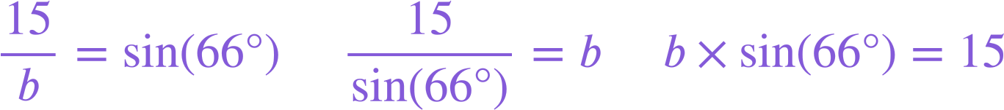
Formalising the sine formula
We can substitute values in a right-angled triangle into each version of the sine formula to represent the relationship between the side opposite an angle and the hypotenuse in different ways.
b cm
15 cm
66°

Slide 12



Formalising the sine formula
Which of these correctly shows the relationship between the hypotenuse and the side opposite the 82° angle for this triangle (rounded to the nearest integer)?
a
d
100 cm
99 cm
b
e
82°
c

Slide 13
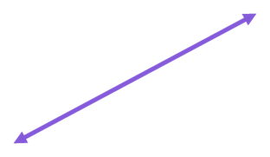
Formalising the sine formula
Which of these correctly shows the relationship between the hypotenuse and the side opposite the angle θ° for this triangle (rounded to the nearest integer)?
a
89 cm
d
b
θ°
e
116 cm
c

Slide 14
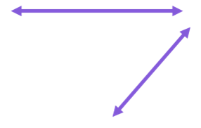
Formalising the sine formula
1) Substitute the labelled sides and angle in each triangle into these two versions of the sine formula.
For each triangle, choose the most appropriate version of the sine formula to find the length of its missing side.
× sin( ) =
× sin( ) =
119
b cm
49°
119 cm
81°
2 cm
=
=
sin( )
sin( )
a cm

Slide 15

Formalising the sine formula
2) Match the triangle to the equation showing the relationship between its hypotenuse and an opposite side.
Use the equation to find the length of the missing side labelled x on each triangle (2 d.p.)
a)
b)
c)
50 cm
32 cm
x cm
50°
32°
x cm
32°
x cm
50 cm
x × sin(32°) = 50
d
50 × sin(32°) = x
e
32 × sin(50°) = x
f

Slide 16
Formalising the sine formula
3) By using the sine formula, find the length of the missing side labelled with a letter for each of these triangles (2 d.p.)
a)
b)
c)
1 cm
14.9 cm
14.9 cm
a cm
b cm
c cm
39°
39°
49°
d)
e)
f)
d cm
e cm
41°
f cm
14.9 cm
49 cm
49°
49°
14.9°
14.9 cm

Slide 17
Formalising the sine formula
4) Find the lengths of the distances a, b, c, and d (rounded to the nearest integer).
d cm
10 cm
b cm
64 cm
50 cm
c cm
39.5 cm
a cm
27°

Slide 18
Formalising the sine formula
1) Substitute the labelled sides and angle in each triangle into these two versions of the sine formula.
For each triangle, choose the most appropriate version of the sine formula to find the length of its missing side.
× sin( ) =
× sin( ) =
119
81°
a
b
49°
2
b cm
49°
a
119 cm
2
81°
2 cm
119
b
=
=
sin( )
sin( )
81°
49°
a cm = 117.53 cm
b cm = 2.65 cm
a cm

Slide 19
Formalising the sine formula
2) Match the triangle to the equation showing the relationship between its hypotenuse and an opposite side.
Use the equation to find the length of the missing side labelled x on each triangle (2 d.p.)
c)
x cm
32°
a)
b)
50 cm
50°
32 cm
x cm
32°
50 cm
50 × sin(32°) = x
x cm
e
x × sin(32°) = 50
d
32 × sin(50°) = x
f
x = 26.50
x = 94.35
The side opposite 32° has a length of 26.50 cm
x = 24.51
The hypotenuse has a length of 94.35 cm
The side opposite 50° has a length of 24.51 cm

Slide 20
Formalising the sine formula
3) By using the sine formula, find the length of the missing side labelled with a letter for each of these triangles (2 d.p.)
a)
b)
c)
1 cm
14.9 cm
14.9 cm
a cm
b cm
c cm
39°
39°
49°
a = 0.63
b = 9.38
c = 11.25
d)
e)
f)
d cm
e cm
41°
f cm
14.9 cm
49 cm
49°
49°
14.9°
14.9 cm
d = 19.74
e = 22.71
f = 190.56

Slide 21
Formalising the sine formula
4) Find the lengths of the distances a, b, c, and d (rounded to the nearest integer).
44 cm
d cm
10 cm
37 cm
b cm
64 cm
50 cm
c cm
39.5 cm
a cm
44
cm
23 cm
27°

Slide 22
Using the sine ratio
Formalising the sine formula
Calculating angles using the sine formula

Slide 23
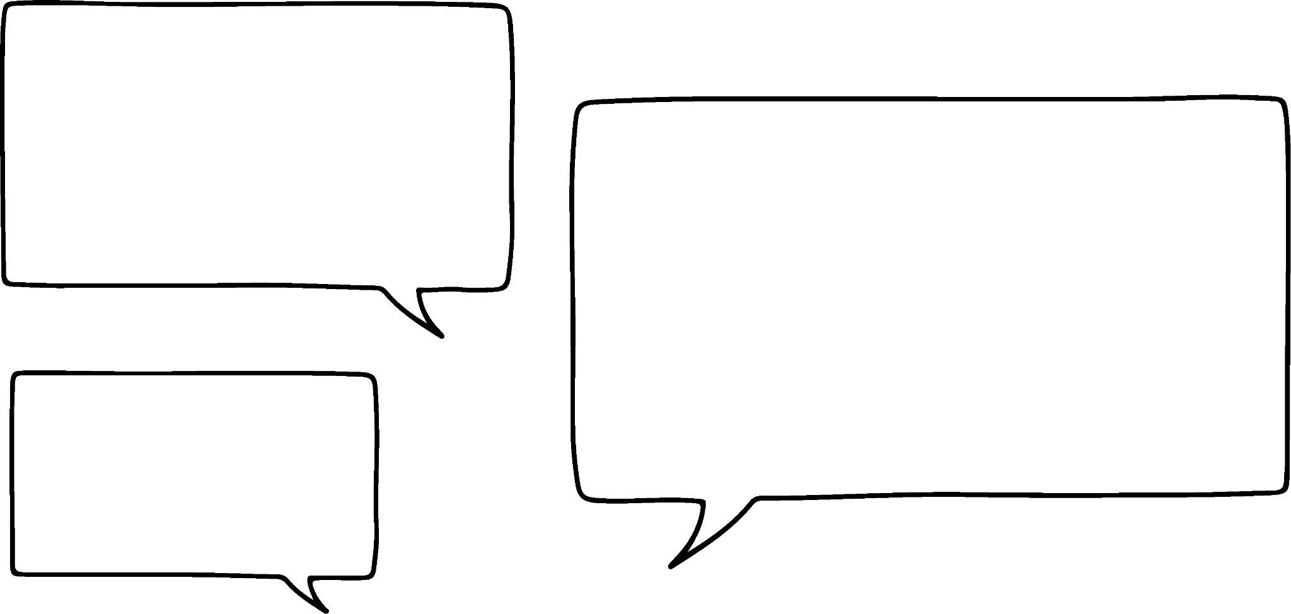
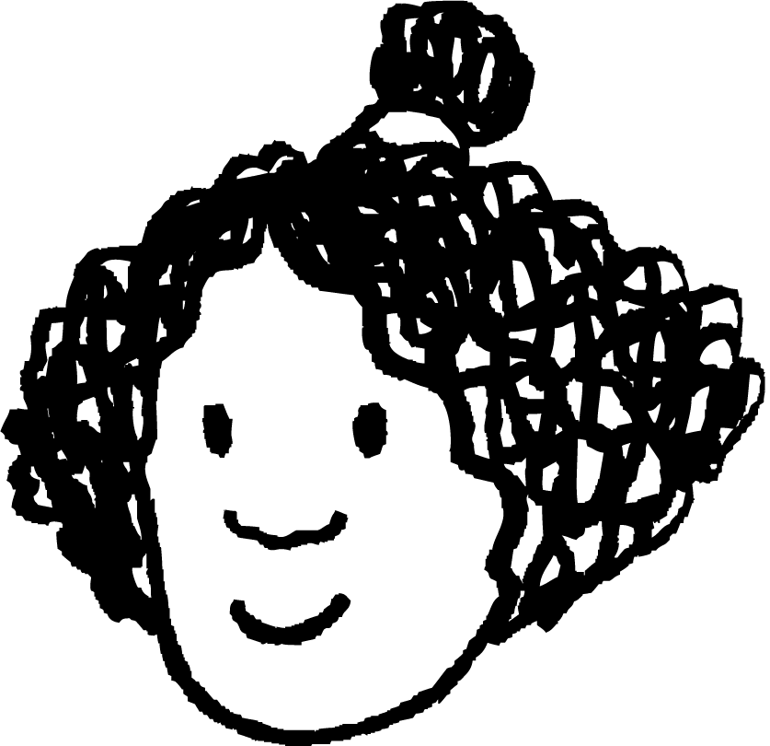
Calculating angles using the sine formula
angle | sine | cosine | tangent
0 | 0 | 1 | 0
5 | 0.087 | 0.996 | 0.087
10 | 0.174 | 0.985 | 0.176
15 | 0.259 | 0.966 | 0.268
20 | 0.342 | 0.94 | 0.364
25 | 0.423 | 0.906 | 0.466
30 | 0.5 | 0.866 | 0.577
35 | 0.574 | 0.819 | 0.7
40 | 0.643 | 0.766 | 0.839
45 | 0.707 | 0.707 | 1
50 | 0.766 | 0.643 | 1.192
55 | 0.819 | 0.574 | 1.428
60 | 0.866 | 0.5 | 1.732
65 | 0.906 | 0.423 | 2.145
70 | 0.94 | 0.342 | 2.747
75 | 0.966 | 0.259 | 3.732
80 | 0.985 | 0.174 | 5.671
85 | 0.996 | 0.087 | 11.43
90 | 1 | 0 | ∞
I’m confident I can use the sine function to find the length of the hypotenuse or opposite in a right-angled triangle…
I know how to find the value of x on this triangle, since it’s a triangle from the unit circle.
Izzy
79 cm
hyp
79 × sin(42°) cm
52.86 cm
x cm
opp
42°

Slide 24
Calculating angles using the sine formula
angle | sine | cosine | tangent
0 | 0 | 1 | 0
5 | 0.087 | 0.996 | 0.087
10 | 0.174 | 0.985 | 0.176
15 | 0.259 | 0.966 | 0.268
20 | 0.342 | 0.94 | 0.364
25 | 0.423 | 0.906 | 0.466
30 | 0.5 | 0.866 | 0.577
35 | 0.574 | 0.819 | 0.7
40 | 0.643 | 0.766 | 0.839
45 | 0.707 | 0.707 | 1
50 | 0.766 | 0.643 | 1.192
55 | 0.819 | 0.574 | 1.428
60 | 0.866 | 0.5 | 1.732
65 | 0.906 | 0.423 | 2.145
70 | 0.94 | 0.342 | 2.747
75 | 0.966 | 0.259 | 3.732
80 | 0.985 | 0.174 | 5.671
85 | 0.996 | 0.087 | 11.43
90 | 1 | 0 | ∞
…but is it possible to find the size of an angle using the sine formula?
Izzy
hyp
10 cm
7.07 cm
opp
θ°

Slide 25
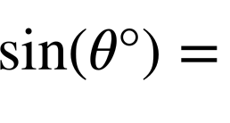
Calculating angles using the sine formula
angle | sine | cosine | tangent
0 | 0 | 1 | 0
5 | 0.087 | 0.996 | 0.087
10 | 0.174 | 0.985 | 0.176
15 | 0.259 | 0.966 | 0.268
20 | 0.342 | 0.94 | 0.364
25 | 0.423 | 0.906 | 0.466
30 | 0.5 | 0.866 | 0.577
35 | 0.574 | 0.819 | 0.7
40 | 0.643 | 0.766 | 0.839
45 | 0.707 | 0.707 | 1
50 | 0.766 | 0.643 | 1.192
55 | 0.819 | 0.574 | 1.428
60 | 0.866 | 0.5 | 1.732
65 | 0.906 | 0.423 | 2.145
70 | 0.94 | 0.342 | 2.747
75 | 0.966 | 0.259 | 3.732
80 | 0.985 | 0.174 | 5.671
85 | 0.996 | 0.087 | 11.43
90 | 1 | 0 | ∞
We can use the version of the sine formula where sin(θ°) is the subject.
sine
Substitute the lengths of the hypotenuse and the side opposite θ°.
45
0.707
7.07
0.707
= 0.707
10
To find the angle, we find 0.707 in the sine column and check its corresponding angle.
hyp
10 cm
7.07 cm
opp
45°
θ°

Slide 26
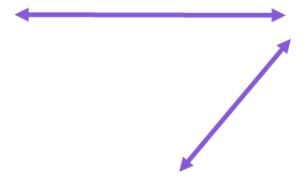
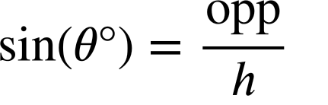
Calculating angles using the sine formula
angle | sine | cosine | tangent
0 | 0 | 1 | 0
5 | 0.087 | 0.996 | 0.087
10 | 0.174 | 0.985 | 0.176
15 | 0.259 | 0.966 | 0.268
20 | 0.342 | 0.94 | 0.364
25 | 0.423 | 0.906 | 0.466
30 | 0.5 | 0.866 | 0.577
35 | 0.574 | 0.819 | 0.7
40 | 0.643 | 0.766 | 0.839
45 | 0.707 | 0.707 | 1
50 | 0.766 | 0.643 | 1.192
55 | 0.819 | 0.574 | 1.428
60 | 0.866 | 0.5 | 1.732
65 | 0.906 | 0.423 | 2.145
70 | 0.94 | 0.342 | 2.747
75 | 0.966 | 0.259 | 3.732
80 | 0.985 | 0.174 | 5.671
85 | 0.996 | 0.087 | 11.43
90 | 1 | 0 | ∞
Izzy has found the value of sin(θ°) for this triangle.
By using the lookup table, find the size of the angle θ°.
sine
25 cm
θ°
23.5 cm
θ° = 70°
23.5
= 0.94
25
70
0.94

Slide 27
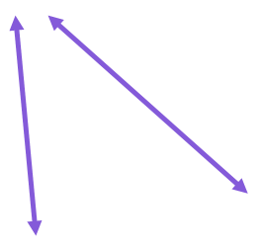
Calculating angles using the sine formula
angle | sine | cosine | tangent
0 | 0 | 1 | 0
5 | 0.087 | 0.996 | 0.087
10 | 0.174 | 0.985 | 0.176
15 | 0.259 | 0.966 | 0.268
20 | 0.342 | 0.94 | 0.364
25 | 0.423 | 0.906 | 0.466
30 | 0.5 | 0.866 | 0.577
35 | 0.574 | 0.819 | 0.7
40 | 0.643 | 0.766 | 0.839
45 | 0.707 | 0.707 | 1
50 | 0.766 | 0.643 | 1.192
55 | 0.819 | 0.574 | 1.428
60 | 0.866 | 0.5 | 1.732
65 | 0.906 | 0.423 | 2.145
70 | 0.94 | 0.342 | 2.747
75 | 0.966 | 0.259 | 3.732
80 | 0.985 | 0.174 | 5.671
85 | 0.996 | 0.087 | 11.43
90 | 1 | 0 | ∞
By substituting the lengths of the hypotenuse and the side opposite to θ° into the sine formula, use the lookup table to find the size of the angle θ°.
sine
200 cm
173.2 cm
θ°
θ° = 60°
60
0.866
173.2
= 0.866
200

Slide 28
Calculating angles using the sine formula
angle | sine | cosine | tangent
0 | 0 | 1 | 0
5 | 0.087 | 0.996 | 0.087
10 | 0.174 | 0.985 | 0.176
15 | 0.259 | 0.966 | 0.268
20 | 0.342 | 0.94 | 0.364
25 | 0.423 | 0.906 | 0.466
30 | 0.5 | 0.866 | 0.577
35 | 0.574 | 0.819 | 0.7
40 | 0.643 | 0.766 | 0.839
45 | 0.707 | 0.707 | 1
50 | 0.766 | 0.643 | 1.192
55 | 0.819 | 0.574 | 1.428
60 | 0.866 | 0.5 | 1.732
65 | 0.906 | 0.423 | 2.145
70 | 0.94 | 0.342 | 2.747
75 | 0.966 | 0.259 | 3.732
80 | 0.985 | 0.174 | 5.671
85 | 0.996 | 0.087 | 11.43
90 | 1 | 0 | ∞
sine
Oh no!
What if I get a value of sin(θ°) that isn’t in the table?
20
25
0.342
0.423
7
Izzy
= 0.35
20
I can see on the table that θ° is in between 20° and 25°, but can I be more precise?
20 cm
7 cm
θ°

Slide 29
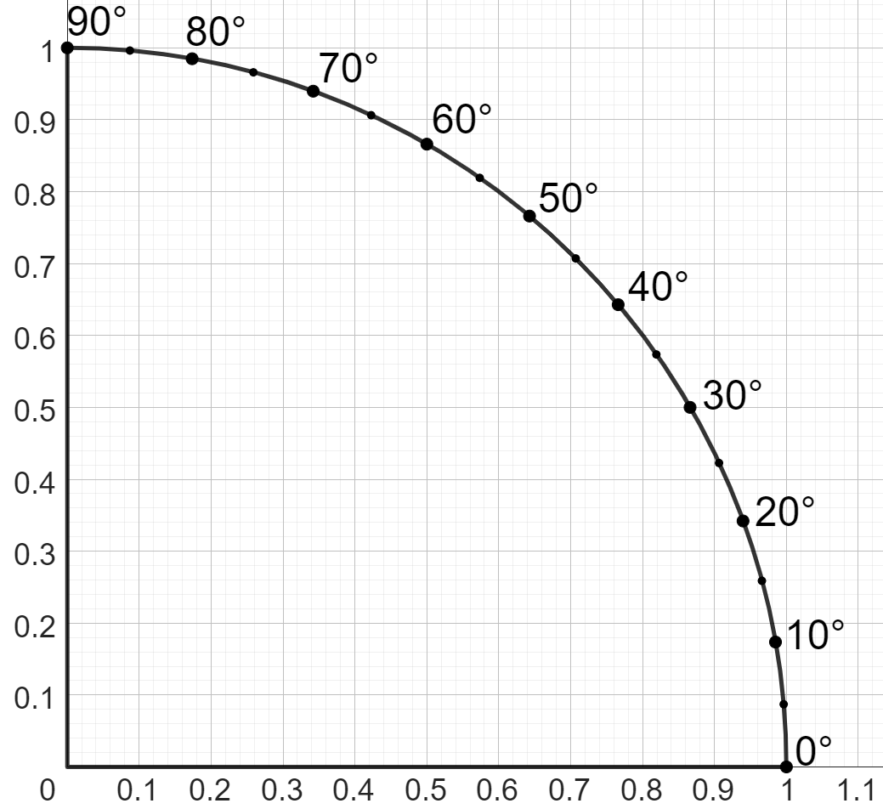
Calculating angles using the sine formula
You can also find the size of angle θ° by reading off of the axes of the unit circle, starting at the y-axis.
7
= 0.35
20
20 cm
7 cm
0.35 units
θ°
21°
The angle θ° is approximately 21°.

Slide 30
Calculating angles using the sine formula
Using the unit circle is better than the table, but it’s so long-winded, and still not that precise.
Izzy
Is there a more precise way of finding an angle?
Similar to how we can use a calculator to find the length of a side?

Slide 31
Calculating angles using the sine formula
On a unit circle, we can find the length of a side opposite the angle 30° by applying the sine function to that angle:
sin( 30° ) =
30°
0.5
angle
length of side on unit circle
1 unit
The sine function has an inverse function called the arcsine function.
You may see it as sin⁻¹ on a calculator.
30°

Slide 32
Calculating angles using the sine formula
On a unit circle, we can find the length of a side opposite the angle 30° by applying the sine function to that angle:
sin( 30° ) =
30°
0.5
arcsine
arcsine
30°
=
sin⁻¹(0.5)
1 unit
sin⁻¹(30° ) =
30°
0.5
30°
length of side on unit circle
angle

Slide 33
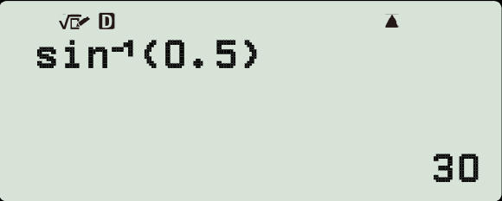

Calculating angles using the sine formula
We can use the arcsine function on a calculator to find an angle.
sin⁻¹( 30° ) =
30°
0.5
1 unit
30°

Slide 34
Calculating angles using the sine formula
Which of the following equations is correct when finding the size of angle n° in the equation:
sin(n°) = 0.24?
a
c
b
d

Slide 35
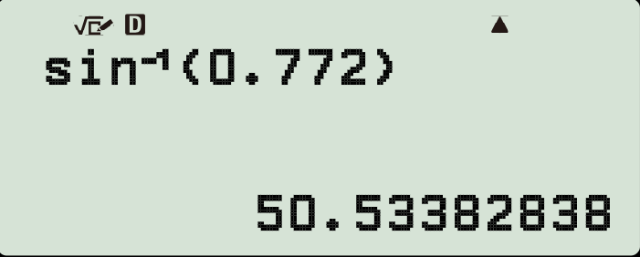
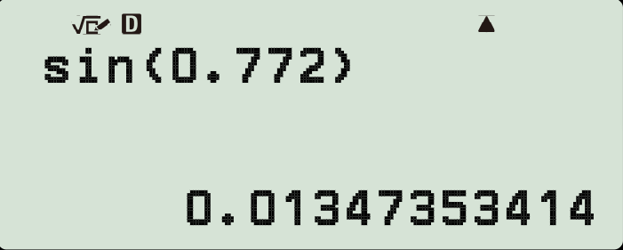


Calculating angles using the sine formula
Which calculator display is correct when trying to find the size of angle p° in the equation:
sin(p°) = 0.772?
a
b
Finding the size of an angle will require the use of arcsine, which is shown by sin⁻¹ on a calculator.

Slide 36
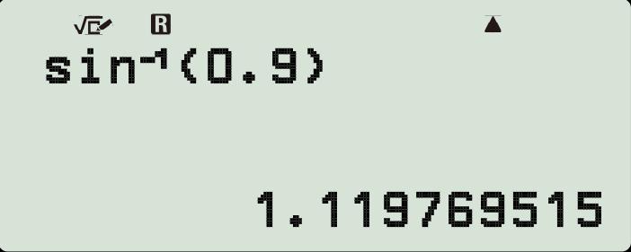
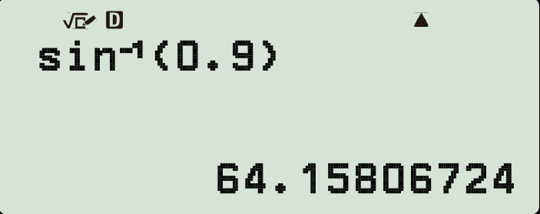

Calculating angles using the sine formula
Which calculator display is correct when trying to find the size of angle y° in the equation:
sin(y°) = 0.9?
a
b
Both answers have been input into the calculator correctly.
However, the calculator in a has been set to radians, not degrees. Therefore, its result is not an angle given in degrees.

Slide 37
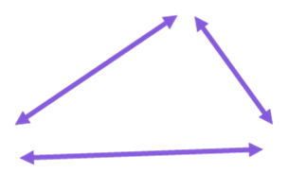
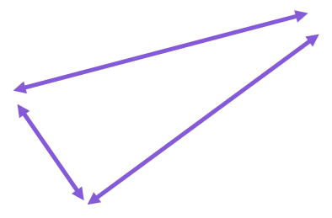
Calculating angles using the sine formula
angle | sine | cosine | tangent
0 | 0 | 1 | 0
5 | 0.087 | 0.996 | 0.087
10 | 0.174 | 0.985 | 0.176
15 | 0.259 | 0.966 | 0.268
20 | 0.342 | 0.94 | 0.364
25 | 0.423 | 0.906 | 0.466
30 | 0.5 | 0.866 | 0.577
35 | 0.574 | 0.819 | 0.7
40 | 0.643 | 0.766 | 0.839
45 | 0.707 | 0.707 | 1
50 | 0.766 | 0.643 | 1.192
55 | 0.819 | 0.574 | 1.428
60 | 0.866 | 0.5 | 1.732
65 | 0.906 | 0.423 | 2.145
70 | 0.94 | 0.342 | 2.747
75 | 0.966 | 0.259 | 3.732
80 | 0.985 | 0.174 | 5.671
85 | 0.996 | 0.087 | 11.43
90 | 1 | 0 | ∞
1) Using this table of trig values, find the size of each missing angle marked with a letter.
45.3 cm
25 cm
8.55 cm
b°
a°
50 cm
sin(a°) =
8.55
=
sin(b°) =
=
25
0.866 cm
200 cm
d°
1 cm
c°
17.4
cm

Slide 38
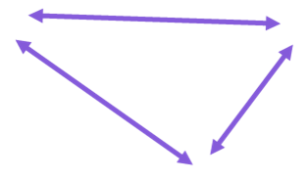
Calculating angles using the sine formula
2) By drawing appropriate lines on this part of a unit circle, estimate the size of each angle marked with a letter (to the nearest integer).
12 cm
sin(a°) =
12
=
0.8
15
a° =
15 cm
a°
25 cm
42 cm
b°
c°
11
cm
12.6 cm

Slide 39
Calculating angles using the sine formula
3) Use your calculator to find the size of each angle marked with a letter (1 d.p.)
22 cm
24 cm
b°
9 cm
1 cm
a°
0.48 cm
18 cm
c°
sin(a°) =
9
sin(b°) =
24
a° = sin⁻¹(
9
)
b° = sin⁻¹(
)
=
=
24
3 cm
0.5 cm
0.5 cm
0.24 cm
0.48 cm
f°
d°
0.48 cm
e°

Slide 40
Calculating angles using the sine formula
angle | sine | cosine | tangent
0 | 0 | 1 | 0
5 | 0.087 | 0.996 | 0.087
10 | 0.174 | 0.985 | 0.176
15 | 0.259 | 0.966 | 0.268
20 | 0.342 | 0.94 | 0.364
25 | 0.423 | 0.906 | 0.466
30 | 0.5 | 0.866 | 0.577
35 | 0.574 | 0.819 | 0.7
40 | 0.643 | 0.766 | 0.839
45 | 0.707 | 0.707 | 1
50 | 0.766 | 0.643 | 1.192
55 | 0.819 | 0.574 | 1.428
60 | 0.866 | 0.5 | 1.732
65 | 0.906 | 0.423 | 2.145
70 | 0.94 | 0.342 | 2.747
75 | 0.966 | 0.259 | 3.732
80 | 0.985 | 0.174 | 5.671
85 | 0.996 | 0.087 | 11.43
90 | 1 | 0 | ∞
1) Using this table of trig values, find the size of each missing angle marked with a letter.
45.3 cm
25 cm
8.55 cm
65°
20°
50 cm
8.55
45.3
sin(a°) =
0.342
sin(b°) =
0.906
=
=
25
50
0.866 cm
200 cm
5°
60°
1 cm
17.4
cm

Slide 41
Calculating angles using the sine formula
2)
Any angle ± 2° of what is given is a sensible estimate.
12 cm
sin(a°) =
12
=
0.8
15
a° ≈
53°
15 cm
a°
25 cm
42 cm
17°
26°
11
cm
12.6 cm

Slide 42
Calculating angles using the sine formula
3) Use your calculator to find the size of each angle marked with a letter (1 d.p.)
22 cm
24 cm
b°
9 cm
1 cm
a°
0.48 cm
18 cm
c°
9
sin(b°) =
18
sin(a°) =
22
24
c° = 28.7°
a° = sin⁻¹(
9
)
22.0°
b° = sin⁻¹(
18
)
54.9°
=
=
24
22
e° = 73.7°
3 cm
0.5 cm
0.5 cm
0.24 cm
0.48 cm
f°
d°
0.48 cm
d° = 9.2°
f° = 28.7°
e°

Slide 43
Using the sine ratio
The relationship between the hypotenuse of a right-angled triangle and the side opposite an angle θ° can be written as a formula in different ways:
This sine formula can be used to find the length of the hypotenuse, the length of the side opposite an angle θ°, or the size of angle θ° itself.
In order to find the size of an angle, the function inverse to the sine function must be used: the arcsine function.
On a calculator, the arcsine function is usually written as sin⁻¹.

Slide 44

© Oak National Academy 2024.
Produced in partnership with Mathematics in Education and Industry.
Licensed on the Open Government Licence v3.0, except where otherwise stated. See Oak terms and conditions.

